Slide 1
The Value of a Life: Zero Suicide in Healthcare
David Covington, LPC, MBA
zerosuicide.org

Slide 2
Looking at Suicide Differently

Slide 3
Polling Question #1
Someone who died by hanging with their hands bound behind their back and feet tied together was probably a murder, not a suicide.
True
False
Notes:
Sadly, the answer is False. According to Dr. Thomas Joiner, it is not uncommon for individuals who are attempting to end their life to bind their feet, then their hands and attempt to end their life by hanging. While this is extremely difficult for those of us who have not experienced debilitating psychic pain and suicidal thoughts, we are going to discuss in this presentation what motivates this behavior.
http://www.foxnews.com/us/2011/07/15/body-millionaires-girlfriend-found-hanging-at-mansion-may-be-suicide/

Slide 4
The Forgotten Patient
Notes:
Forbes Magazine, 2010 “The Forgotten Patient”

Slide 5
Pyramid of Suicidal Behaviors
38,364 Suicides*
572,000 Hospitalizations**
752,000 Attempts Requiring Medical Attention**
1,100,000
Suicide Attempts**
8,700,000
Seriously Considered Suicide**
Source: * National Center for Injury Prevention and Control, Centers for Disease Control and Prevention. (2009). Web-based Injury Statistics Query and Reporting System (WISQARS). Available from: www.cdc.gov/injury/wisqars/index.html.
**Substance Abuse and Mental Health Services Administration, Results from the 2010 National Survey on Drug Use and Health: Mental Health Findings, NSDUH Series H-42, HHS Publication No. (SMA) 11-4667. Rockville, MD: Substance Abuse and Mental Health Services Administration, 2012.

Slide 6
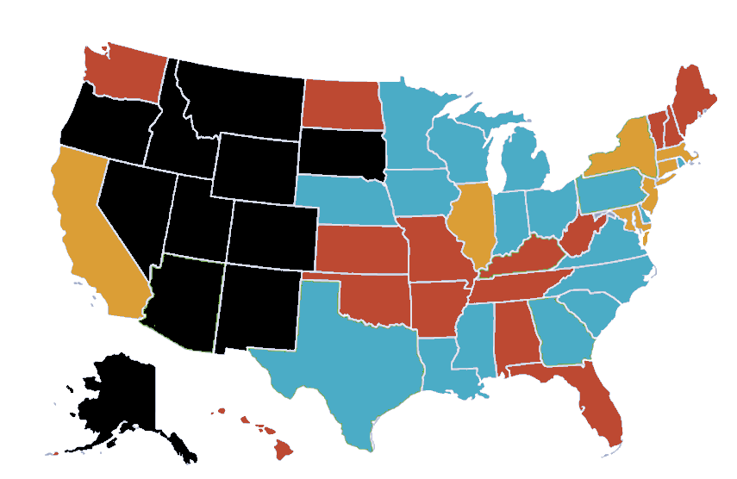
Suicide Rates (2010 National Average Rate 12.4)
14.0
6.8 to 10.5
10.6 to 13.9
14 to 16.9
17 to 23
16.9
13.9
10.6
10.5
6.8
14.5
20.1
23.2

Slide 7
Suicide Rates by Age, Race, & Gender
Source: National Center for Health Statistics. Note: Non-Hispanic Ethnicity

Slide 8
What Have We Learned Over the Past Decade

Slide 9
Polling Question #2
Suicide Can Be Prevented.
Never in Those Truly Intent on Suicide
Sometimes, but Only in Advance of Acute Risk
Always, but Only in Advance of Acute Risk
Always, Even Up to the Last Moment
Notes:
We believe the answer is D, always, even up to the last moment. We are going to discuss the rationale for this hopeful perspective in the next slides.

Slide 10
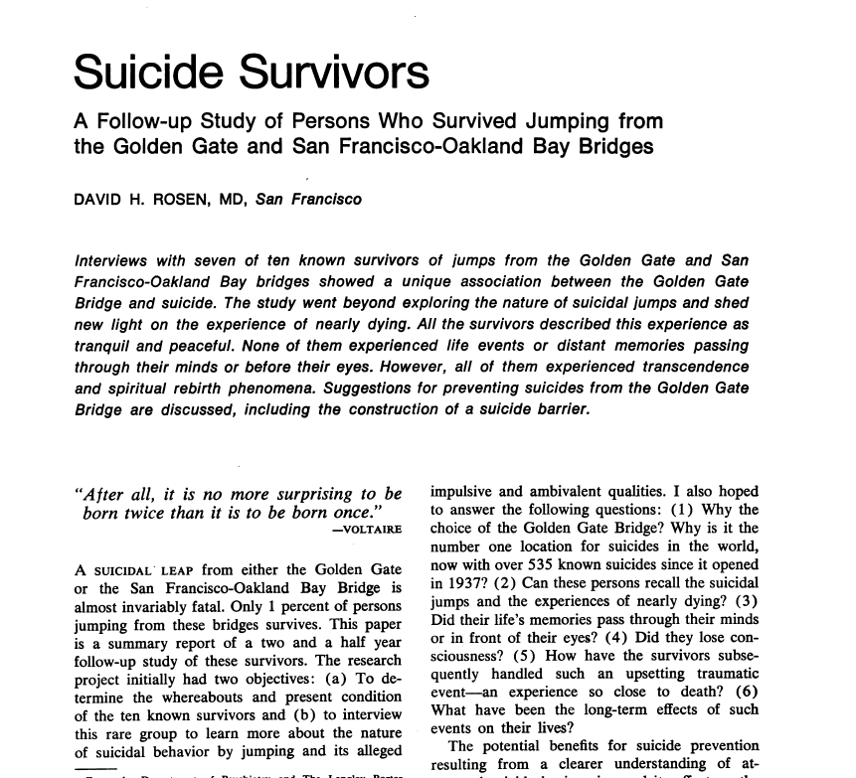
2010
2006
2005
2003
1990
1978
1975

Slide 11
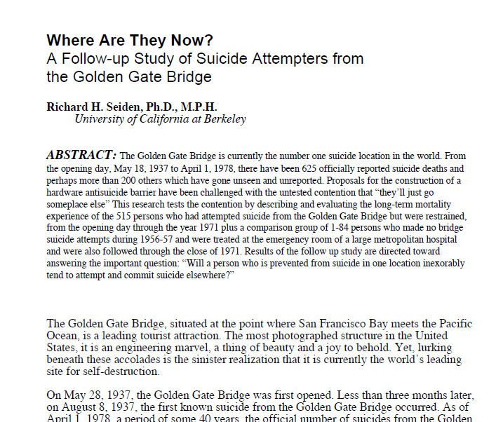
2010
2006
2005
2003
1990
1978
1975

Slide 12
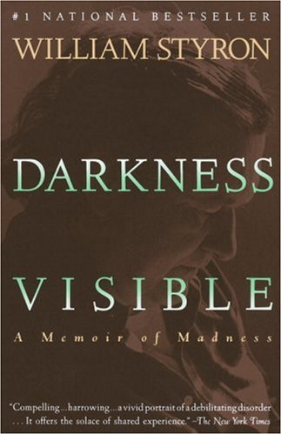
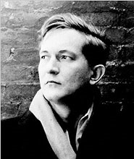
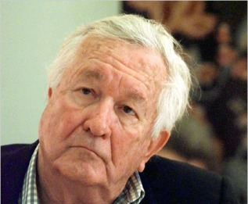
2010
2006
2005
2003
1990
1978
1975

Slide 13
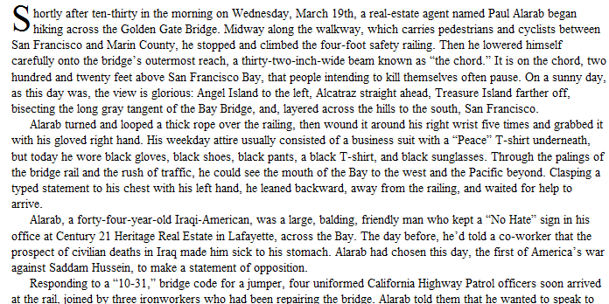
2010
2006
2005
2003
1990
1978
1975

Slide 14
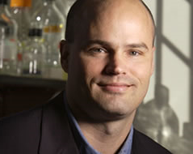
2010
2006
2005
2003
1990
1978
1975

Slide 15
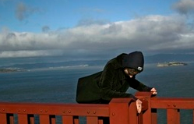
2010
2006
2005
2003
1990
1978
1975

Slide 16
Suicide Attempts:
Female>>male
Rates peak in adolescence
Concern: Latina youth and LGBT
Suicide Deaths:
Male : female = 4:1
Elderly white males
Working aged males (60%)

Slide 17
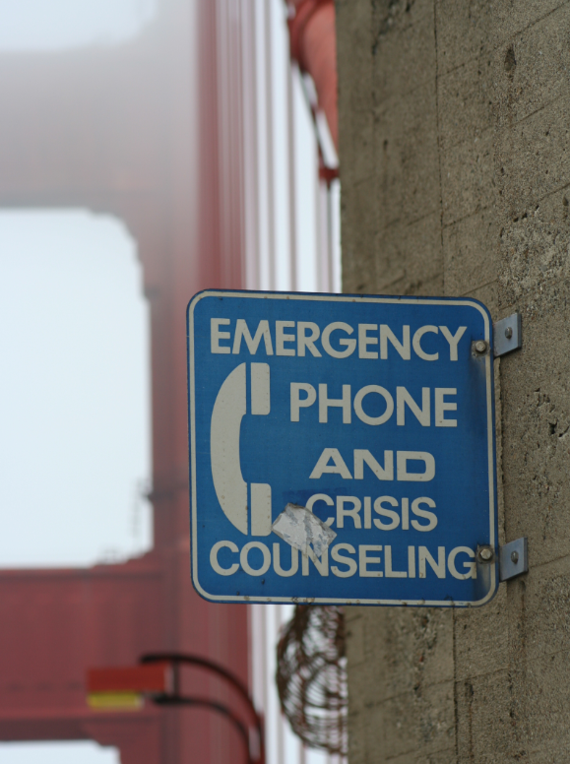
Group A
Group B

Slide 18
Ambivalence is Universal
Diagnosis is Not Destiny: Survivors Survive!

Slide 20
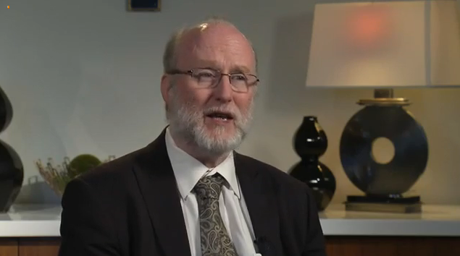
Richard McKeon, SAMHSA
“Over the decades, individual [mental health] clinicians have made heroic efforts to save lives… but systems of care have done very little.”

Slide 21
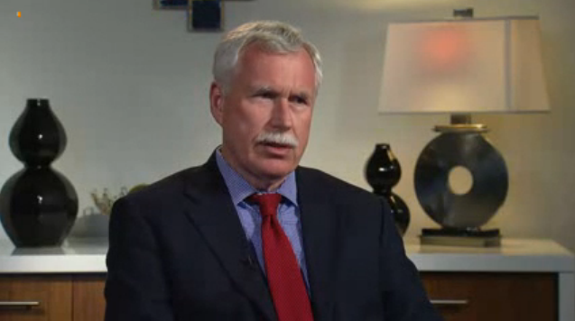
Mike Hogan, Former State MH Commissioner
“Suicide represents a worst case failure in mental health care. We must work to make it a ‘never event’ in our programs and systems of care.”

Slide 22
What Inspired Zero Suicide?

Slide 23
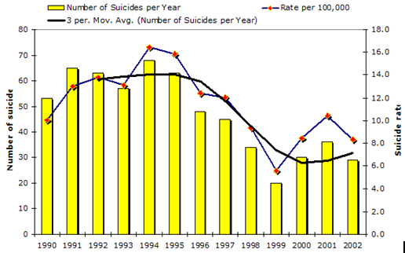
The Air Force Did It

Slide 24
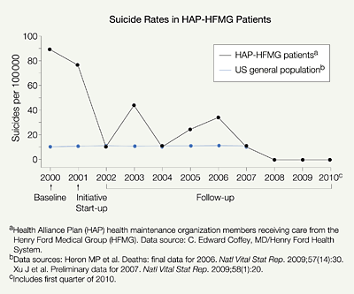
Henry Ford Also Did It

Slide 25
Suicide Care in System Framework
From: | To:
Training and tools | Systems & culture change
Individual provider actions; suicide care as “specialty” | Suicide prevention woven into all aspects of care; everyone’s job
Episodes of crisis | Continuity of care

Slide 26
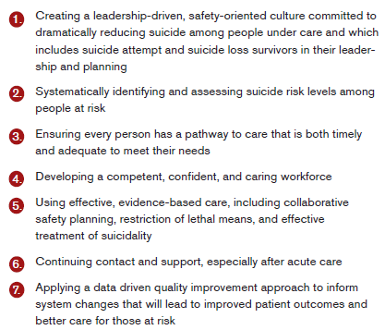
What Can You Do?

Slide 27
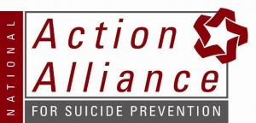
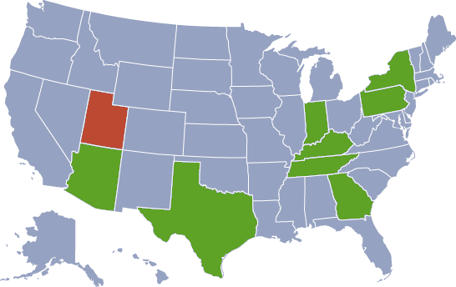
National Survey of 30,000 MH Professionals Across Nine States
ZS Advisory Board (Mike Hogan & David Covington Co-leads)
6,816
1,123
8,344
658
2,507
771
6,292
Learning Collaborative, Julie Goldstein-Grumet
1,562
3,802
Learning Collaborative, Meena Dayak

Slide 28
Question 16 of 16. (Behavioral Health)

Slide 29
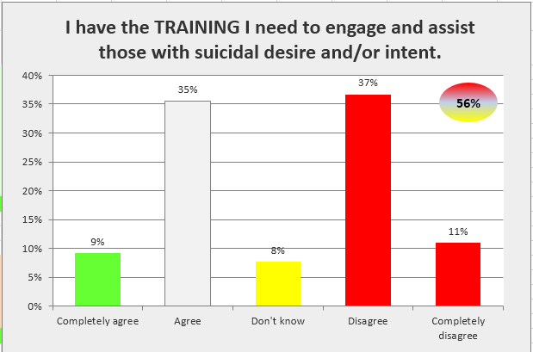
Question 13. TRAINING (Behavioral Health)

Slide 30
The Survey Results
Over 6,000 report a patient has died by suicide (27%).
Role | #
Counselor | 2,421
Social Worker | 2,361
Physician | 416
Nurse | 1,371
Case Manager | 3,312
Para-professionals | 826
Certified Peer Staff | 479
Administrator | 2,640
Support Staff | 3,409
Once
3,314 / 15%
More than once
2,792 / 13%
I have the _________ to engage and assist those who are suicidal.
SMI Suicide Rate vs. General Population
Skills
44%
Supports
30%
One/Three
53%
Training
39%
Endorsed Don’t Know, Disagree, or Completely Disagree

Slide 31
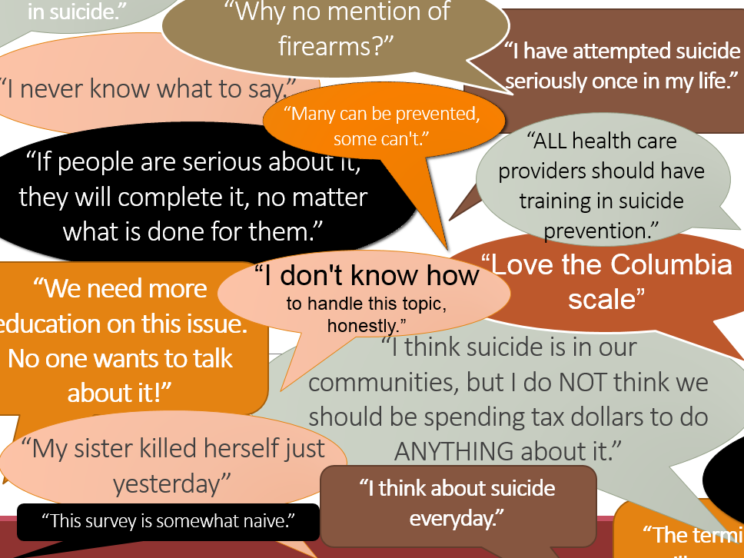

Slide 32
How to Become Suicide Safer

Slide 33
TERROS
One of a dozen founding organizations of the programmatic suicide deterrent system in 2009.

Slide 34
Workforce Composition
Certified Peer Staff
6%
Admin &
Non-clinical
26%
Case Managers
30%
Clinicians/
Social Workers
35%
Physicians/ Nurses
3%
PC

Slide 35
2009 Survey
Suicide deaths reported by clinicians
11% of Agency Staff Report Specific Suicide Care Training (ASIST)
PC

Slide 36
2012 Survey
81% of Agency Staff Report Specific Suicide Care Training (ASIST)
PC

Slide 37
Comparing Two Cultures
Training 2) Skills
3) Supervision/Support

Slide 38
zerosuicide.com

Slide 39
Contact Us
Zero Suicide Advisory Group Co-Leads
david.covington@crisisaccess-co.com
dr.m.hogan@gmail.com
Social Networking
http://www.linkedin.com/in/davidwcovington
https://twitter.com/davidwcovington
https://www.facebook.com/david.covington
http://www.youtube.com/davidcovington
zerosuicide.org

