Slide 1
Is Alcohol Use Really a Direct Risk Factor for Suicide?
Peter M. Gutierrez, Ph.D.
Show Me You Care About Suicide Prevention Conference
July 15, 2014
Jefferson City, MO
This work was in part supported by the Military Suicide Research Consortium (MSRC), an effort supported by the Office of the Assistant Secretary of Defense for Health Affairs under Awards No. W81XWH-10-2-0178 and W81XWH-10-2-0181). Opinions, interpretations, conclusions and recommendations are those of the presenter and are not necessarily endorsed by the MSRC or the Department of Defense.

Slide 2
Thanks to my Collaborators
Michael Anestis, Ph.D.
Thomas Joiner, Ph.D.
Jetta E. Hanson, M.A.

Slide 3
“... many widely held beliefs … are never exposed to the possibility of criticism, with the result that language transmits not only wisdom but also a type of folly that is difficult to eradicate.”
F.A. Hayek (1988), The Fatal Conceit, p. 106.

Slide 4
Many people who die by suicide are intoxicated at the time of death
“Alcohol use is strongly related to impulsive suicide attempts” (Weiss & Hufford, 1999, p. 301)
“Alcohol, through its disinhibiting effects is related to suicide attempts and completions” (IOM, 2002, p. 81)
“For some, it is a daring recreational maneuver that goes a little too far, often in the setting of drunkenness or a drug high.” (Welte et al., 1988)
Notes:
Harvard Medical School Guide to Suicide Assessment & Intervention
IOM Reducing Suicide: A National Imperative

Slide 5
Have you ever written something like this in a patient’s medical record?
Mr. X’s risk of suicide is greatest when he has been drinking. Therefore, the key to avoiding a future act of self-directed violence is to ensure that he not become intoxicated.

Slide 6

Let’s examine some widely held beliefs

Slide 7
Intoxication facilitates lethal self-harm by lowering inhibitions, impairing judgment, and decreasing coordination and fine motor skill

Slide 8

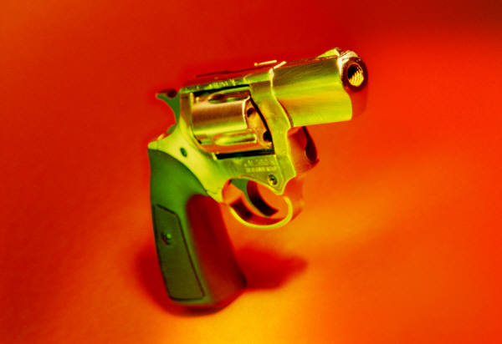
Intoxicated individuals die as a result of accidental weapons discharges, misclassified as suicide

Slide 9


Intoxication facilitates “impulsive” self-directed violence

Slide 10

What are the implications of refuting a long held belief within the suicidology community?

Slide 11
Why does it matter that many suicide decedents likely were not intoxicated at the point when they engaged in lethal self-directed violence?

Slide 12

What might the impact be on treatment planning and disposition decisions?

Slide 13
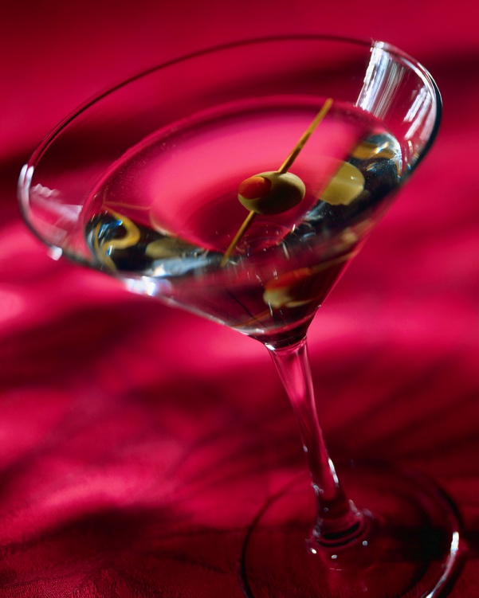


What do we really know about the relationship between alcohol and suicide?

Slide 14
Links between impulsivity and lethality of attempts
Inversely related (Baca-Garcia et al., 2001; Connor et al., 2006; Nakagawa et al., 2009)
Degree of planning and premeditation positively related with lethality
Those diagnosed with substance dependence less likely to make impulsive attempts

Slide 15
Links between alcohol consumption and suicide
Swedish decedents had higher urine than blood alcohol concentration (Ostrom et al., 1996)
  Blood increases after consumption, urine after metabolization
  If alcohol = impulsive, then findings should be the other way around

Slide 16

Fine, but you’ve only cited a few studies, and most are fairly old

Slide 17

What is the current state of the literature?

Slide 18
Comprehensive Review
Multiple databases searched for combination of “BAC”, “blood alcohol content”, and “suicide”
Published in English, human subjects, % decedents with blood alcohol levels, accounted for % died by suicide
92 articles published from 1979 to 2012
167,894 cases available for analyses
Anestis, M. D., Joiner, T., Hanson, J. E., & Gutierrez, P. M. (in press). The modal suicide decedent did not consume alcohol just prior to the time of death: An analysis with implications for understanding suicidal behavior. Journal of Abnormal Psychology.

Slide 19
Variables Recorded
Year published
Number of decedents who died by suicide
Method of suicide
Gender
Age
Ethnicity
Country
Presence of alcohol

Slide 20
Decedent Characteristics
Average of 1,825 per study
  Ranged from 6 to 57,813
75% male
Mean age 42

Slide 21
Presence of Alcohol at Death
Of all suicide decedents, 26.86% had positive blood alcohol content
  Weighted by study sample size
15 studies of accidents (representing 27,975 decedents) reported 31.71% with positive blood alcohol content
18 studies of homicide (representing 18,322 decedents) reported 37.72% with positive blood alcohol content
Notes:
All group differences significant at p < .00001

Slide 22
Do demographics influence results?
Percentage sample male x percentage suicide decedents with positive BAC (r = .05, p = .65)
  Likely due to predominantly male samples across studies
Age x percentage suicide decedents with positive BAC (r = -.17, p = .21)

Slide 23
No, and neither does publication bias
Year of publication x percentage suicide decedents with positive BAC (r = .03, p = .80)

Slide 24
But race matters
Significantly correlated with the percentage of suicide decedents with positive BAC (r = -.54; p = .001)
  Higher proportion of Caucasian decedents, lower frequency of positive BAC
  Not able to parse this finding across samples, so must conclude that multiple factors at play and no definitive explanation at this time

Slide 25

Myth or Supported by Data?

Slide 26
Intoxication facilitates lethal self-harm
Keep in mind that BAC is not the same as intoxication
  And in at least one study urine levels were higher than blood
Maybe, for a small percentage of decedents, but clearly not the norm
  Approximately 27% of almost 170,000 decedents had measurable BAC at time of death

Slide 27
Intoxication facilitates “impulsive” self-directed violence
Predicated on belief that anyone impulsively attempts suicide (Anestis et al., in press)
If this were true, many more decedents would have positive BAC at the time of death
Data would need to confirm that BAC significantly higher than urine levels

Slide 28

Is it accurate to say the modal suicide victim consumed alcohol shortly before the time of death?

Slide 29
Then what can we say?
Alcohol use problems elevate the risk of suicide
  Consumption associated with 20% increase in next hour ideation and 1/3 of attempters consumed alcohol in previous 24 hours (Bagge et al., 2014)
  Proximity of consumption to attempt unknown
People die when intoxicated
Most people likely aren’t intoxicated, nor have they consumed alcohol, prior to suicide

Slide 30
What are the risks for patients?
Clinicians may be making crucial treatment planning and disposition decisions based on faulty assumptions

Slide 31
Unanswered Questions
What percentage of suicide decedents meet criteria for alcohol dependence?
  Positive BAC rates could be artificially inflated by those who are more likely to be positive regardless of what they are doing
How do racial, ethnic, and cultural differences influence the relationship between BAC and suicide?
How does BAC influence choice of method?

Slide 32
Research Implications
Distinguish between + BAC and intoxication by recording levels
Fine grained comparisons by criterion of intoxication
Do some choose not to drink for fear of interfering with attempt?

Slide 33
Clinical Implications
Information about alcohol dependence relevant to overall risk profile
  Likely not useful to think of as warning sign
Underlying problems which lead to alcohol misuse may also be drivers of suicide
  Treating those problems should also address suicide risk
Don’t assume that staying sober will prevent suicide

Slide 34
Clinical Implications
Death by suicide is difficult
Requires confronting high levels of physiological and affective pain
Alcohol consumption factors into the mix, but unlikely to be the primary one for the majority of those who die by suicide

Slide 35
Paradigm Shift
Alcohol consumption is common in the U.S.
Even more common in those with mental disorders
Reasonable to assume it would therefore be quite common in suicide decedents
  Proximal risk factor activated by high stress

Slide 36
Paradigm Shift
Results suggest one of many factors, proximal for some, distal for others
Suicide is difficult and requires planned and deliberate pursuit of death
Identify and treat those factors most likely to contribute to desire and capability to engage in lethal self-harm (Joiner, 2005)
  Many potential mechanisms linking alcohol consumption to suicide
  To date, none empirically tested

Slide 37
Conclusion
Alcohol and suicide do mix, but maybe not in the ways and to the extent many assume
Adopting a different paradigm may lead to more deaths being prevented

Slide 38

Thank You for Your Attention
Peter M. Gutierrez, Ph.D.
Co-Director
Military Suicide Research Consortium
www.msrc.fsu.edu

